Slide 1
OSINT NINJA
Akash Thakur
Content Security TAC
Cisco

Slide 2
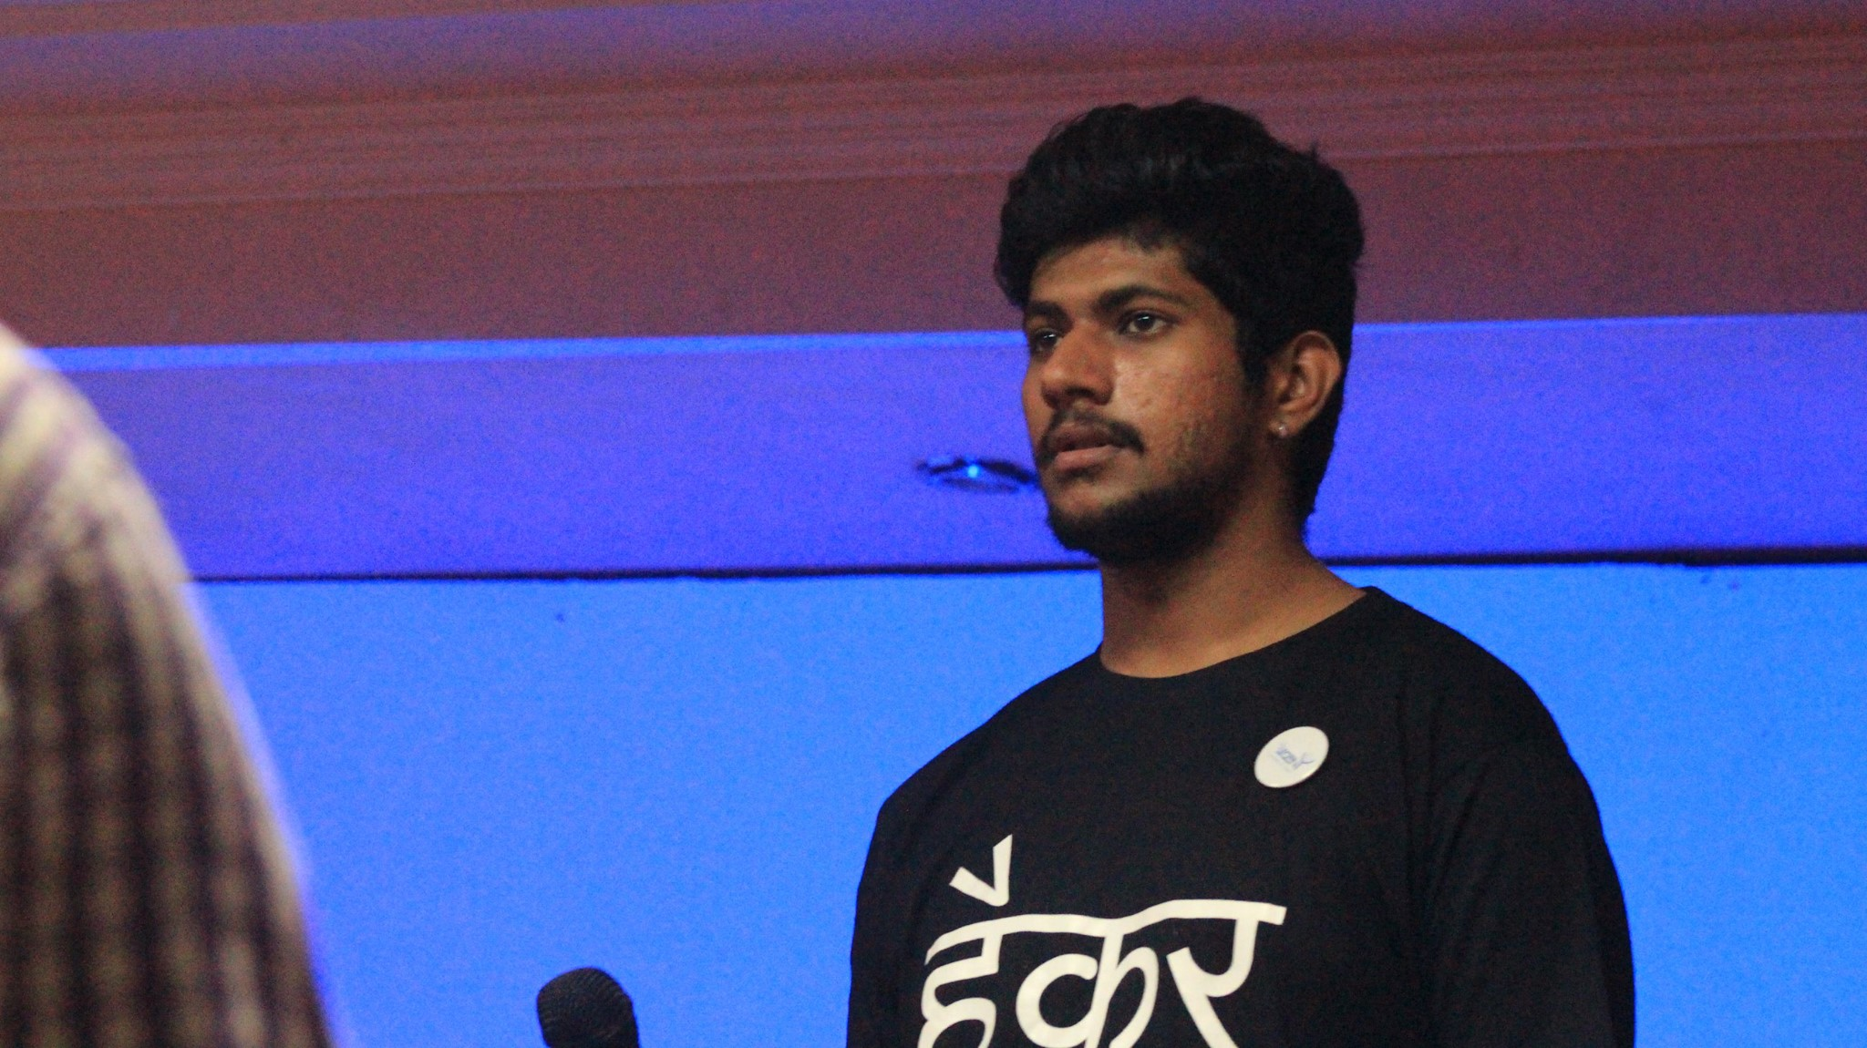
root@me
About Me
Hi ! I’m Akash Thakur.
Curious in learning new technologies and exploring the security doors of it.
I like going for long rides and explore in the wilds.
I come form the land of Himachal Pradesh.
Akash Thakur
Content Security Tac
akashthakur.me
Notes:
Short and relevant: Stay focused on what your audience cares about. Think about what you want them to know, feel and do. Then, say what you need to say and no more.
Bold and human: Be confident in your ideas and in the words you use to express them. Use clear, natural language to connect with your audience and make your message stick.
Show what’s possible and make it real: We call this Dreaming and Doing. When we do it right it's powerful, inspiring, convincing and persuasive.
To learn more, download the brand language guidelines: https://cisco.jiveon.com/docs/DOC-660269

Slide 3

The journey for today
Learn the fundamentals of OSINT
Gain insights to the processes and techniques
Overview of the popular tools used in OSINT
Learn with Tools in Labs
Learn to code your scripts in python
Play the CTF

Slide 4

OSINT
What is OSINT?
Easiest way to define OSINT is via Wikipedia:
“Open-source intelligence​(​OSINT​) is data collected from publicly available sources to be used in an intelligence context”
Or better we say,
OSINT is the process of collecting and analyzing information which is acquired from public and open sources. Public and open are terms that tend to deceive you that they are available freely, but it is not, and that is just one of the things we will talk about here.

Slide 5
PROCESS
Identify ->
Harvesting ->
Data processing ->
Analysis ->
Reporting
Identify : Where you can find the info ?
Harvest : Collect relevant information using OSINT Techniques
Processing: Store Data for processing and meaningful information
Analysis: Join acquired data from multiple sources
Report: Create the report

Slide 6


Classify

Slide 7
From Security perspective
•Offensive: Gathering information before an attack
•Defensive: Learning about attacks against the company.
From state perspective:
• Active: Interactive Session for Information GATHERING
• Passive: Use publicly available information without interactive with target

Slide 8
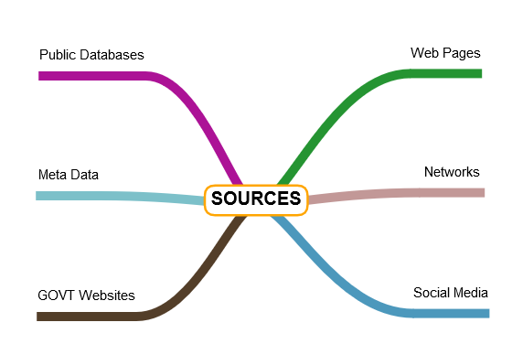
SOURCES OF INFORMATION

Slide 9
Use Cases
Law Enforcement Agencies
  For [Criminal Background Fraud]
Cyber Security Bad Threat Actors
  For not so good purpose
RECONNAISANCE – AKA RECON
  For- [Pentesting or Red teaming]
Competitive Intelligence
  For [National Security]

Slide 10
OSINT Cycle
“Every input comes from some other input’s output” - Joe Gray
Ingest data -> Check for fidelity -> Check for Intelligence -> Logic check -> Is information relevant -> Push data
Does this collaborate with other sources ?
Why does this matter ?
Does this make any sense ?
Does it need to go through workflow ?

Slide 11
WHY SO IMPORANT
Do you regularly check your privacy online ?
People do not take privacy seriously
Internet and tools have made osinf really easy
Social Media needs a strict privacy check
Data and Privacy Regulations
Fact check

Slide 12

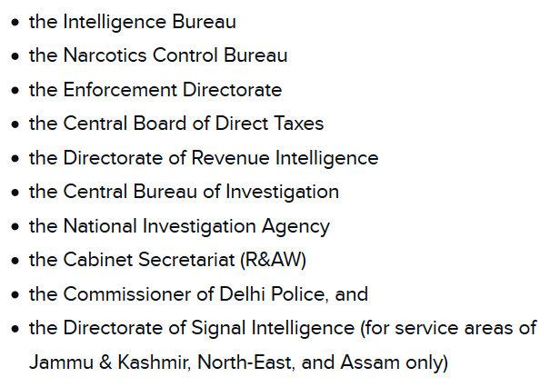

Slide 13
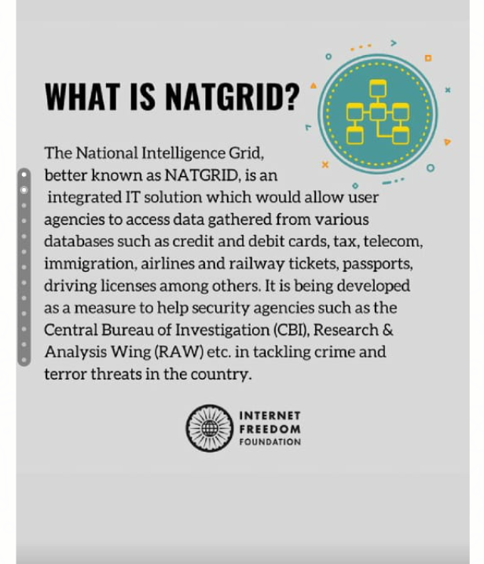

N
A
T
G
R
I
D

Slide 14
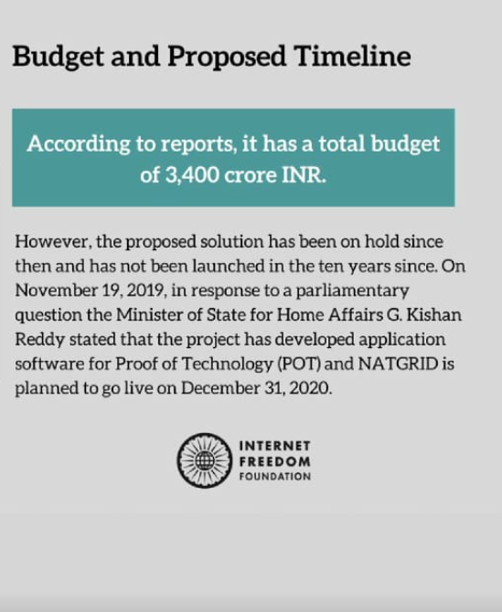
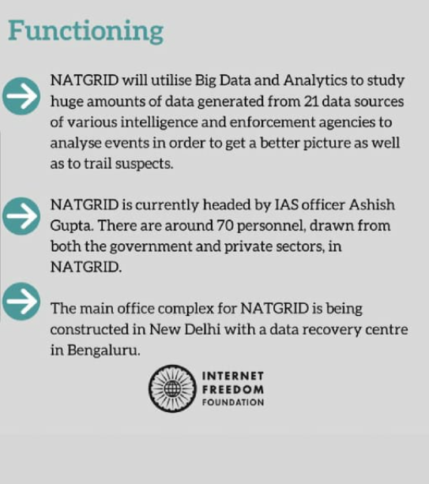


Slide 15
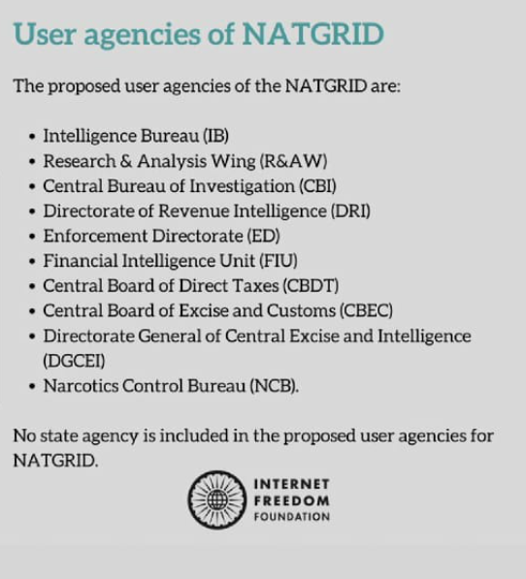
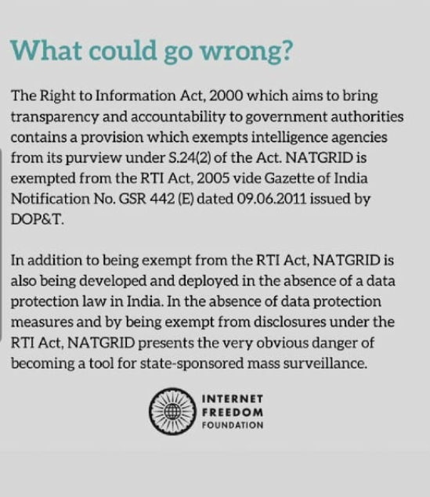
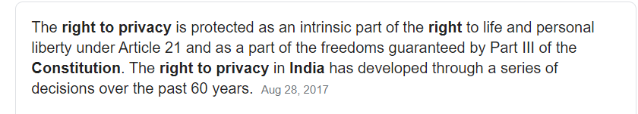

Slide 16


Examples :
A company ABC.COM publishes opening for security engineers with desired skills ?
Can you guess what intelligence context can be developed ?
An employee posts on social media with it’s Company ID card ?
Can you guess any social osinf / intelligence ?
Ans: You can guess about id number patterns, templates etc
Bad actors use this to create fake cards by combining this with RFID cloning techniques
Ans: Firewalls, Web Security Products, Threat Intelligence Platforms, Processes and Standards Used

Slide 17
Legal and Ethical Implications of OSINT
Depending on where you are in the world, you may have to obtain a formal license or permit.
  US: You should have a private investigator license
  India: Good luck somewhere soon
Most of the techniques are passive and will not set any alarm but you have to be careful and not perform any illegal activities.
You are responsible for collecting and securing data
Collect and store data as long as you need it.
I will not be responsible for anything you do after this workshop :P

Slide 18
Break – ox01

Slide 19
DNS
What’s DNS ?
DNS IS:
Naming hierarchy for the internet
Directory service to translate [resolve] the names to IP addresses
A protocol to perform name resolution
In a simple words : DNS is the phonebook of internet, helping you to lookup IP address for specific names.

Slide 20
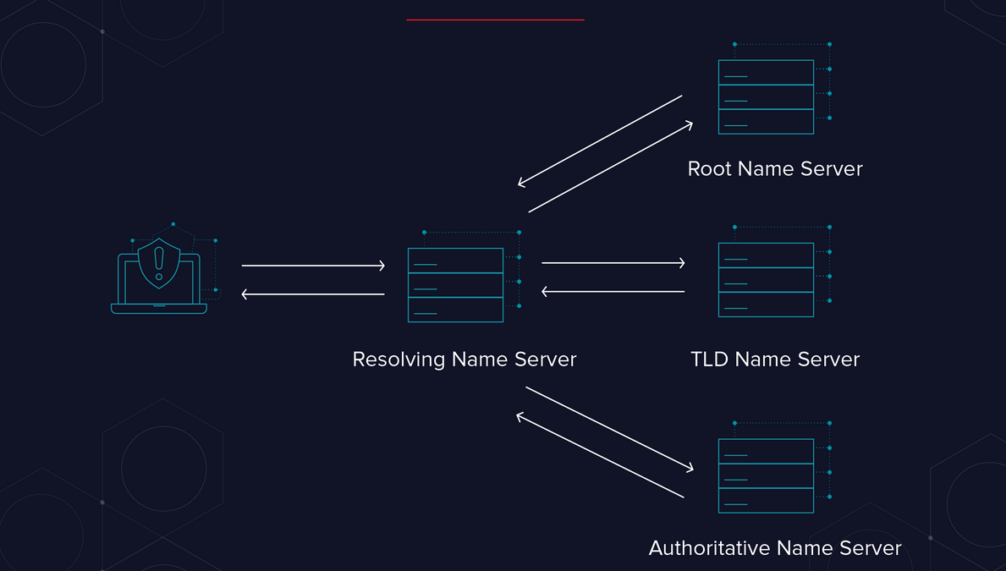
How it works ?

Slide 21
What are the most common types of DNS record?
DNS Records:
A record - The record that holds the IP address of a domain.
CNAME record - Forwards one domain or subdomain to another domain, does NOT provide an IP address.
MX record - Directs mail to an email server.
TXT record - Lets an admin store text notes in the record.
NS record - Stores the name server for a DNS entry.
SOA record - Stores admin information about a domain.
SRV record - Specifies a port for specific services.
PTR record - Provides a domain name in reverse-lookups.

Slide 22
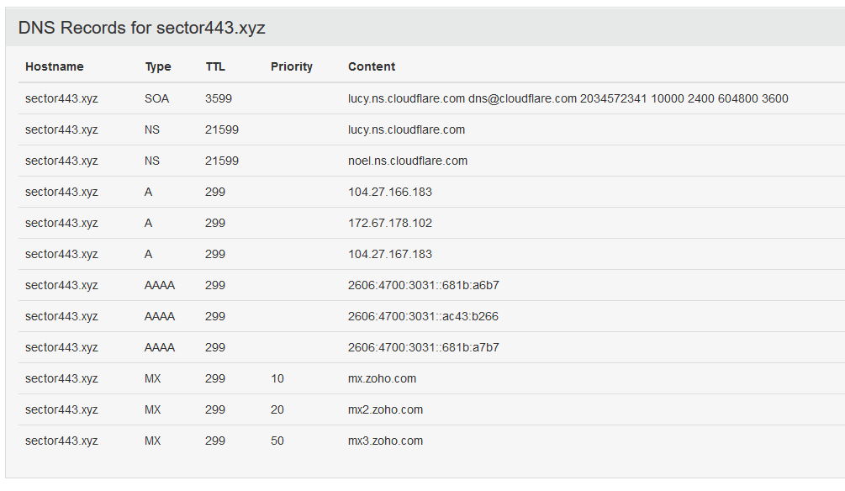

Slide 23
DNSDUMPSTER
https://dnsdumpster.com/
Map an organization attack surface with a virtual dumpster dive* of the DNS records associated with the target organization
  Just like *DUMPSTER DIVING*

Slide 24
WHOIS LOOKUP
Get information about the
  contact details
  address
  Registrar Information
  Domain expiry information
  domain owner name/company
You can contact domain registrar for domain abuse activities
Most often while buying domains people likely prefer paying additional money to hide registration information

Slide 25
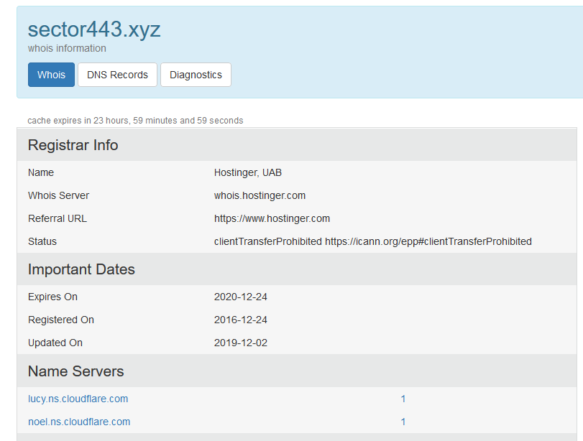
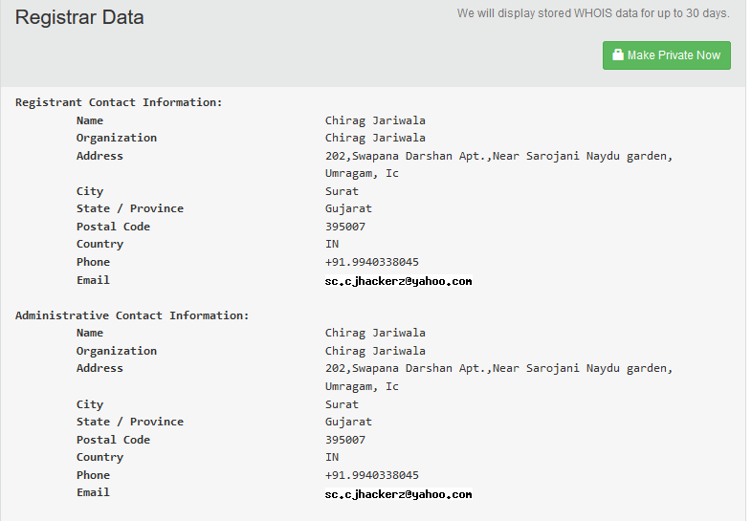
Let’s run some whois lookups
https://who.is/whois/[domain]

Slide 26


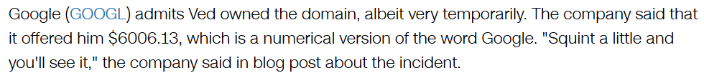
Hacker always expect such mistakes
On a night in September 2015 1:20 a.m when Ved was idly scrolling through domain names.
He saw that Google.com was available for purchase.
Errr…. Domain Expired :P
Ved clicked and added it to his virtual cart.
To his shock he saw the domain name was actually added to his cart.

Slide 27
A bit about internet
Internet – When did it origin?
“The first web page went live on August 6, 1991. It was dedicated to information on the World Wide Web project and was made by Tim Berners-Lee. It ran on a NeXT computer at the European Organization for Nuclear Research, CERN.”
What do you use to search the internet?
“google | bing | yahoo | duck duck go etc”
Works on crawling internet and saving URL’s and metadata
What happens when something is put down on internet ?
“No longer available ! Aww snap ”

Slide 28

How can we see the deleted webpages ?
---- WAYBACK MACHINE ---
https://web.archive.org/web
Search for a domain
Check the captures from past for the domain
Ninja’s use this to gain about information that is possibly deleted from the websites in pass

Slide 29
Break – ox02

Slide 30

Web Stack
How a website is made?
Web pages + Web Server + Backend Programming (Not always)
Web Pages : HTML + CSS + JS
Web Server : Apache, nginX, IIS, Custom server [Werkzurk, python based, nodejs based]
Backend: PHP, Python, Java, Perl, Bash etc
OSINT importance:
Hackers identify potentially vulnerable components used in developing website/webapplication
Webapp Penetration testing | Bug Hunting
An example of conducting Active Osint

Slide 31
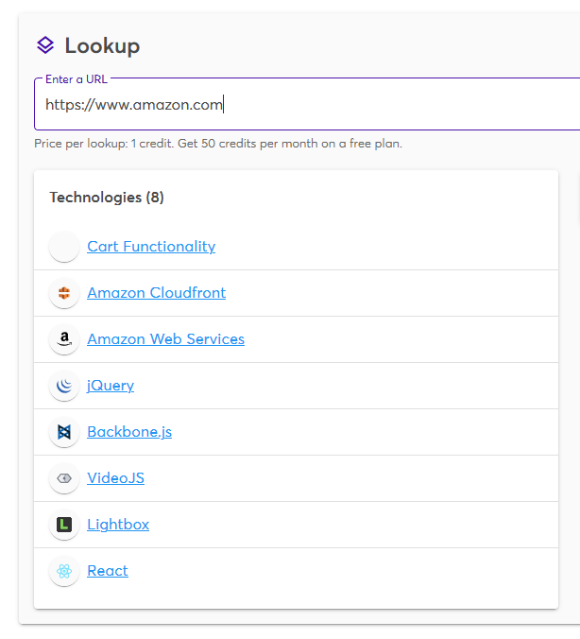
Learn how websites are made -
  What tools are used to deploy the website ?
  What is the frontend stack ? or possible backend stack
TOOLS :
#BUILT WITH - https://builtwith.com/
#WAPPALYZER - https://www.wappalyzer.com/

Slide 32

Pawn test
Visit - https://haveibeenpwned.com/
Simply provide your email address and hit pwned?
Identify if an email address has been part of a data breach
Get details about the data breach
Malicious actors use this for breaking into accounts that have already been hacked. – example forum https://raidforums.com

Slide 33

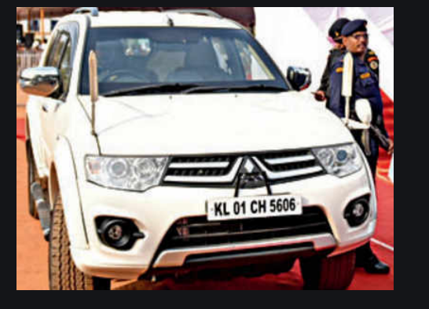

What can I do with these images ?

Slide 34


Gathering Vehicle Info
Take out your mobile phones
Type an SMS to 7738299899
“VAHAN [vehicle number]”
Hit the url on your browser
https://vahan.nic.in/
Enter [vehicle number]

Slide 35


Locating Open Wifi Hotspots
Let say you are travelling to place X.
How will you search for open Wifi hotspots there ?
Visit - https://www.wiman.me/
Achieved using War Driving practice

Slide 36

GOOGLE DORKS
Advance Searching techniques with Google by use of keywords like intitle, in url intext etc
Vulnerability Identification with dorking
Use logical operations to combine and make meaningful queries
You can even search for information which is not intended for public view with the help of this technique.
Keywords :
intitle: inurl: intext: define: site: phonebook: maps: book: info: movie: weather: filetype:
related: link

Slide 37
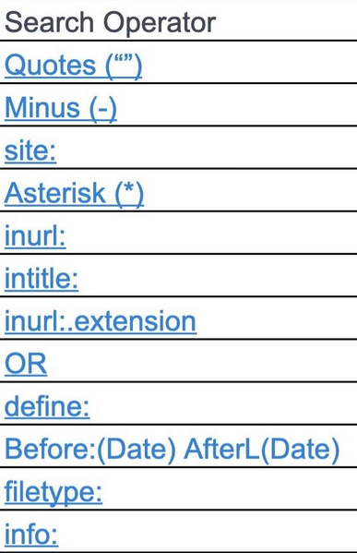
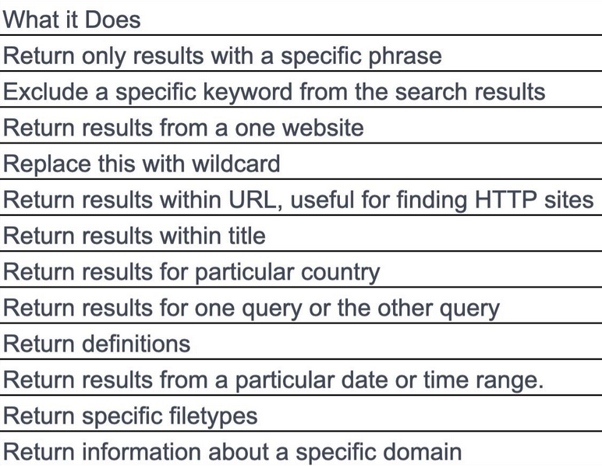

Slide 38

Finding IP Cameras Online
inurl:"view.shtml" "Network Camera"
"Camera Live Image" inurl:"guestimage.html“
inurl:/ViewerFrame? intitle:"Network Camera NetworkCamera“
intitle:NetworkCamera intext:"Pan / Tilt" inurl:ViewerFrame

Slide 39
Files containing passwords :
"/** MySQL database password */" ext:txt | ext:cfg | ext:env | ext:ini
allintext:password filetype:log
intext:"Index of /password“
intitle:"index of" "passwords.xlsx"
Files containing juicy info :
Database:phpmyadmin intext:mysql ext:sql inurl:phpMyAdmin
allintext:"API_SECRET*" ext:env | ext:yml
site:amazonaws.com intext:dhcp filetype:txt
Public Google Drives - inurl:"folderview?id=" site:"drive.google.com“

Slide 40

 | THE HUB : https://www.exploit-db.com/google-hacking-database

Slide 41
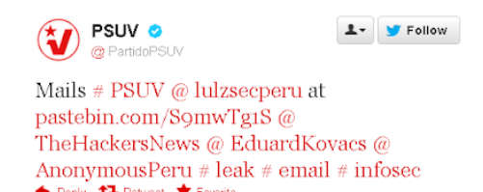
PASTEBIN
Password Dumps | Archives Links
Mostly used by hackers to leak information
Ex: https://pastebin.com/UpNjLRaS | https://pastebin.com/UpNjLRaS
Pastebin + Wayback Machine = MAGIC
Ex: https://pastebin.com/awqUq72B | http://archive.is/j6sgo

Slide 42

SHODAN
Shodan is a network security monitor and search engine focused on the the internet of things. It was created by John Matherly in 2009 to keep track of publicly accessible computers inside any network.
Shodan is pretty much like Google but instead of showing you fancy images and rich content / informative websites,it will show you things that are more related to the interest of IT security researchers like SSH, FTP, SNMP, Telnet, RTSP, IMAP and HTTP server banners and public information
Results will be shown ordered by country, operating system, network, and ports.
Search Engine for IOT
Lookups for IP ports
Lookups for latest devices and affected by - CVE’s

Slide 43
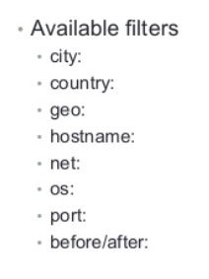

https://www.shodan.io/
Try out:
Search for an IOT device on google
Search for device name on shodan
Refine results with filters
4.Zoom in to specific host and get details

Slide 44

setup_your_warmachine
Open setup_your_warmachine.docx and follow the instructions

Slide 45
Break – ox03

Slide 46
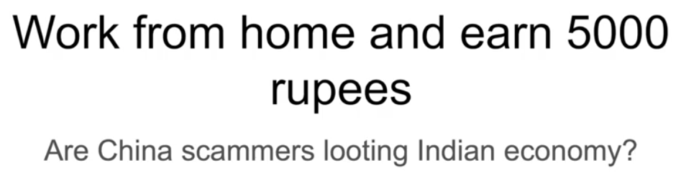

CASE STUDY
Shootout - -

Slide 47
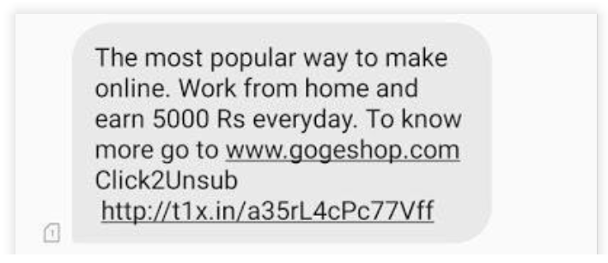
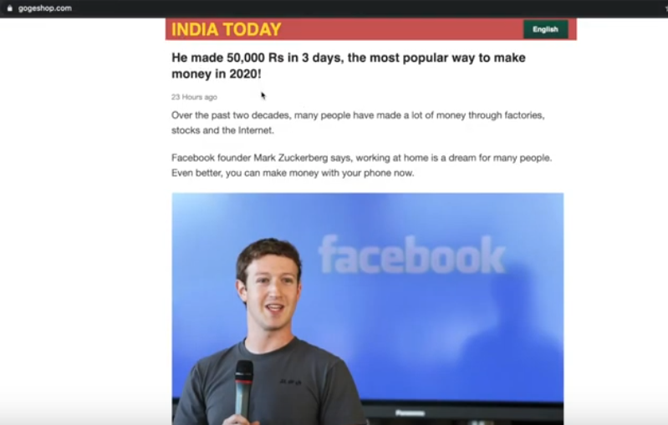
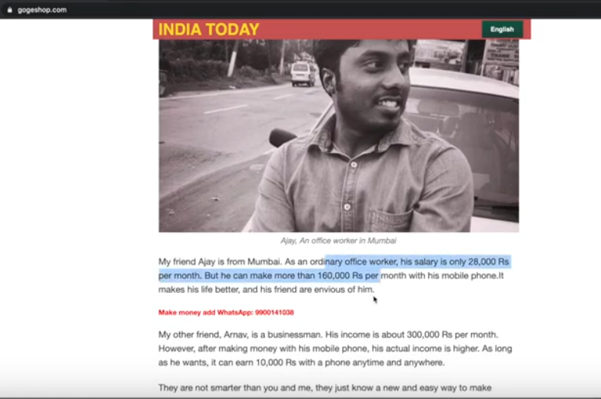
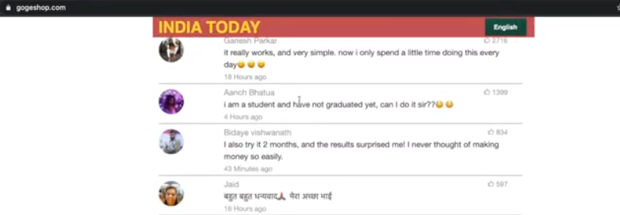
CASE STUDY
A Person X gets this message
After Visiting the website

Slide 48
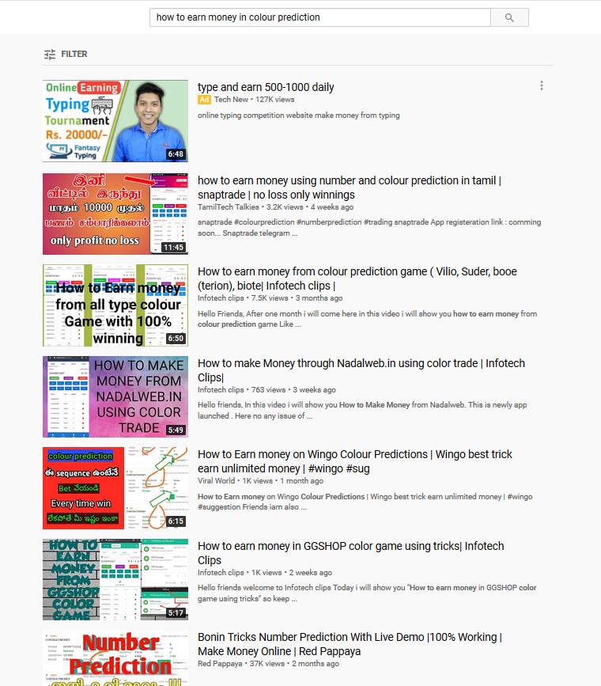
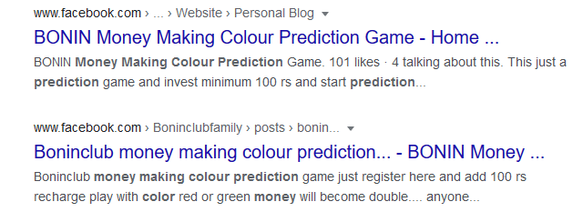
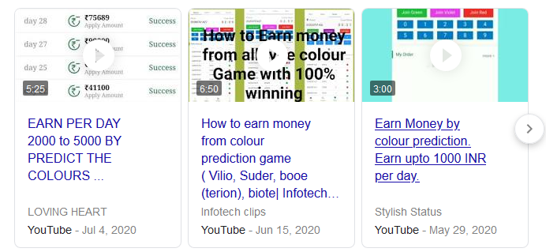
CASE STUDY
Because of the current pandemic, most youngsters are looking for easy ways to earn money online: a simple Google search can point anyone to this kind of website.

Slide 49
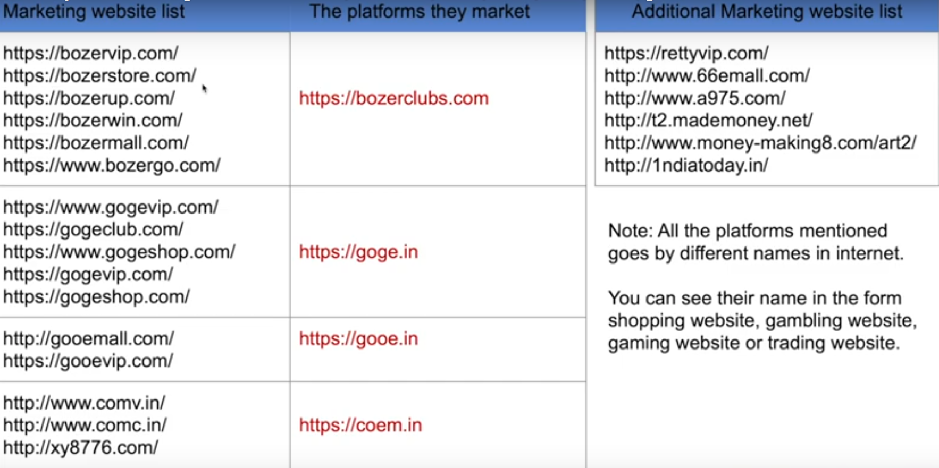
CASE STUDY

Slide 50
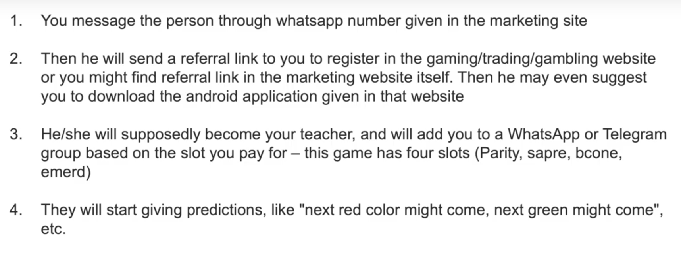
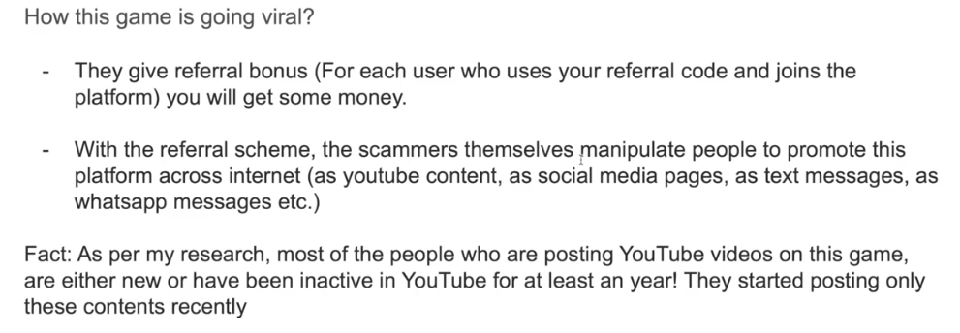
CASE STUDY

Slide 51
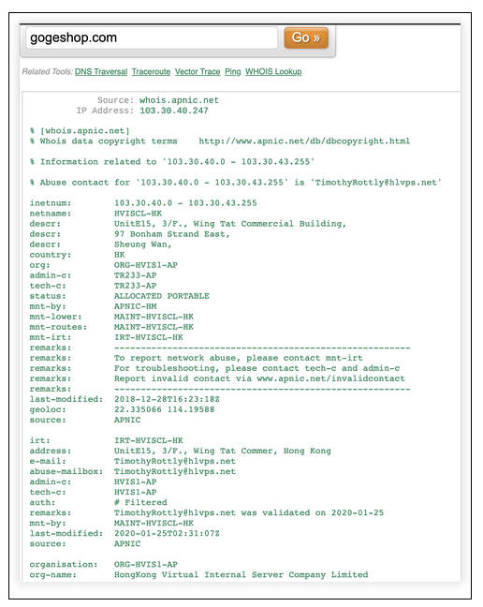
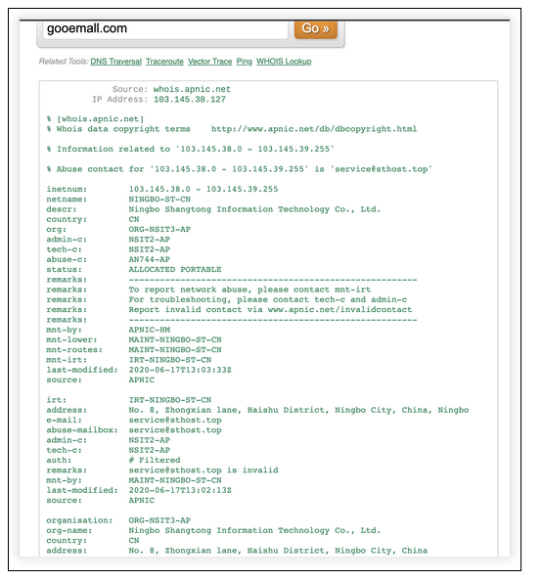
Evidences

Slide 52
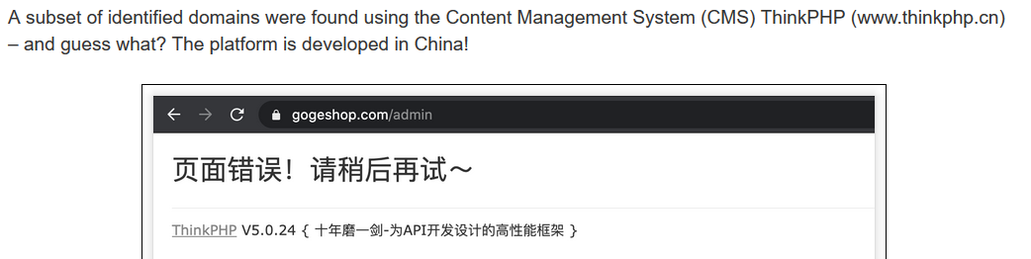
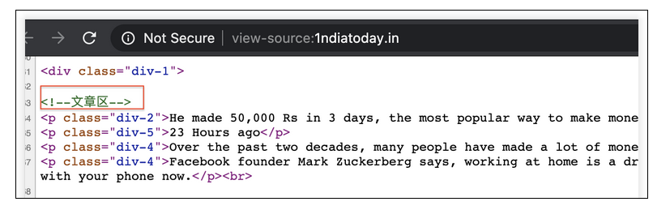
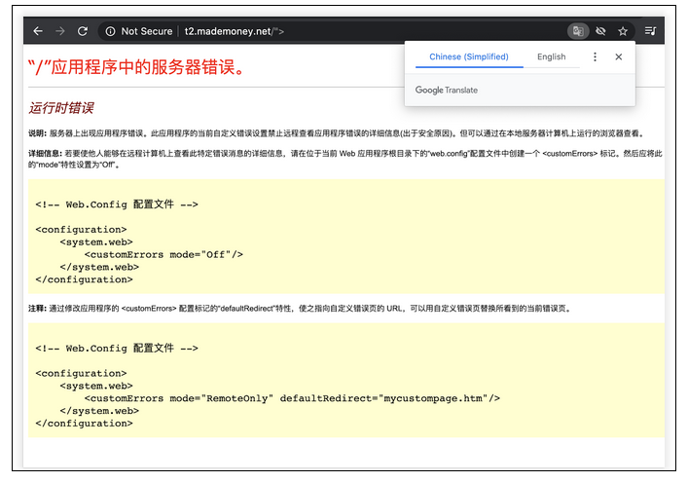
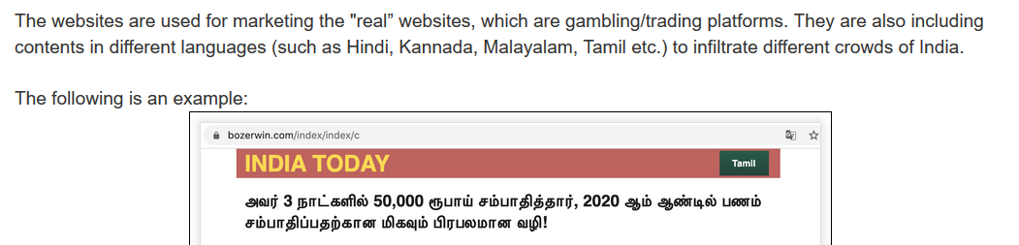
Evidences

Slide 53
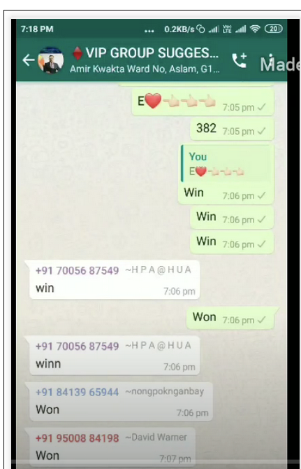
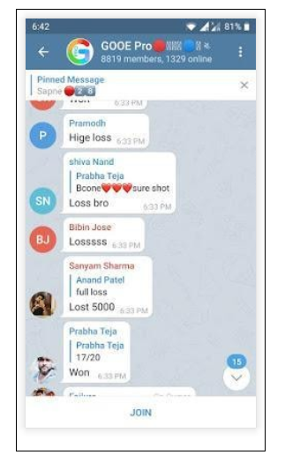
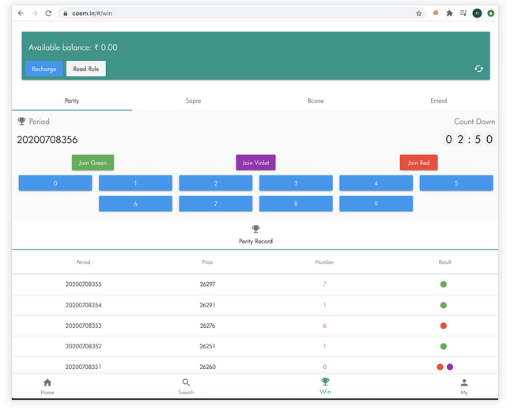
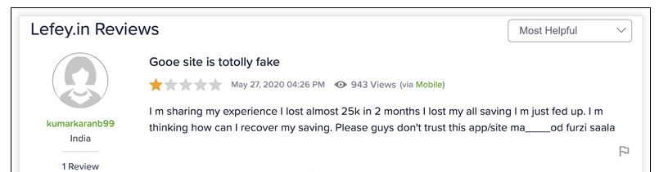
Evidences
The illogical Game

Slide 54
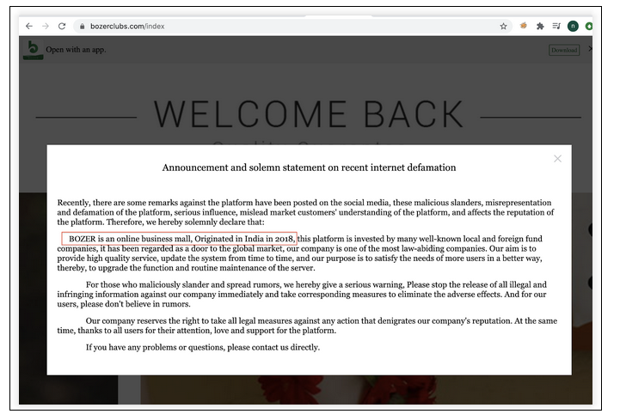
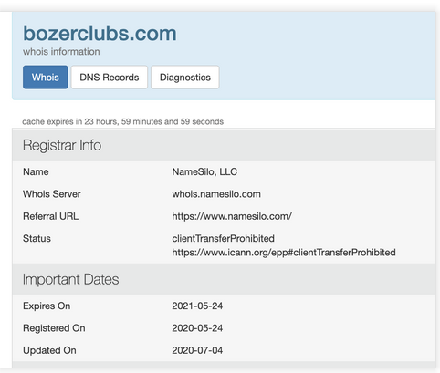
Contradiction
They make everything look so legit.. they have presence in India since 2018 which is, once again, a false claim! As per “whois” records, this domain was registered in the month of May 2020 – so just couple months ago

Slide 55
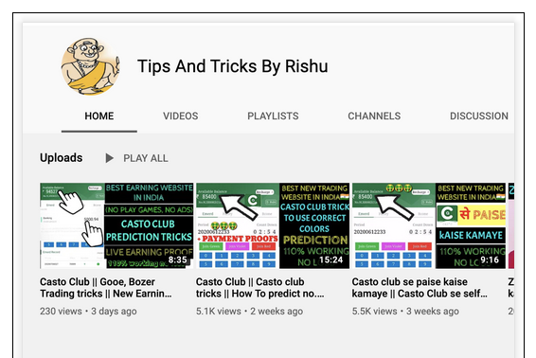
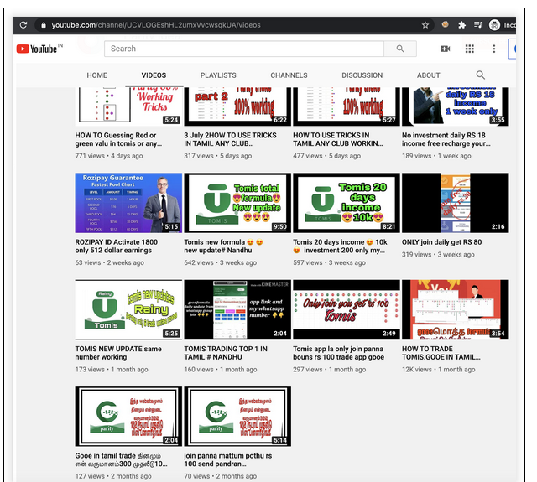
Evidences
Most of the people who are posting YouTube videos on this topic, are either new or have been inactive in YouTube for at least a year! They started posting only these contents recently, which means that they all are getting suggested to post videos and promote this site on social media platforms!

Slide 56
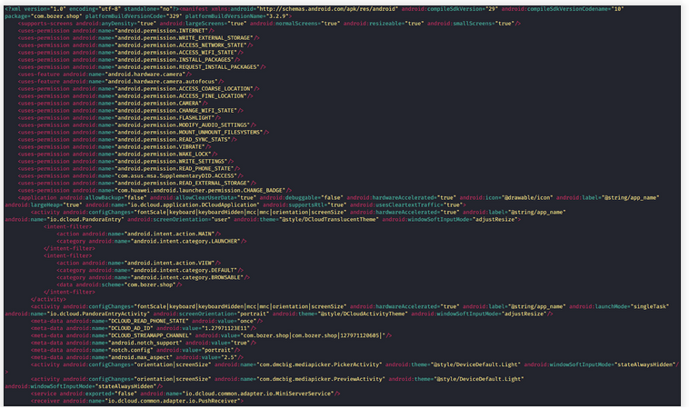
Decompiled APK
Now, coming to their Android app, you need to download the APK directly from their site – none of these available APK are published onto the Google Playstore..

Slide 57
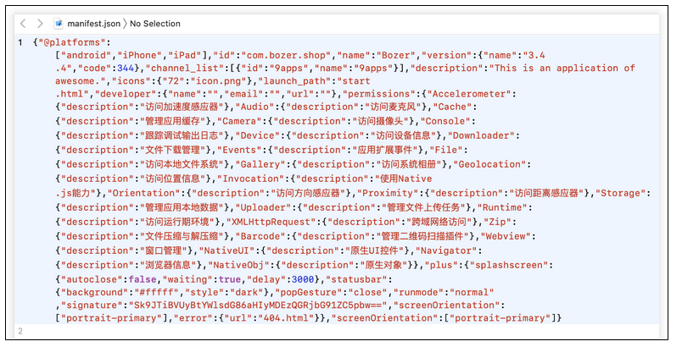
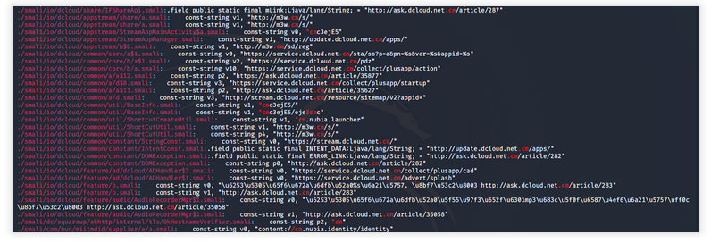
Evidences
Even the APK app’s contents remain the same, just the package’s name, URL endpoints, and the logo change based on the domain the app is linked to.
Code base reveals multiple links pointing to Chinese hostnames .cn

Slide 58
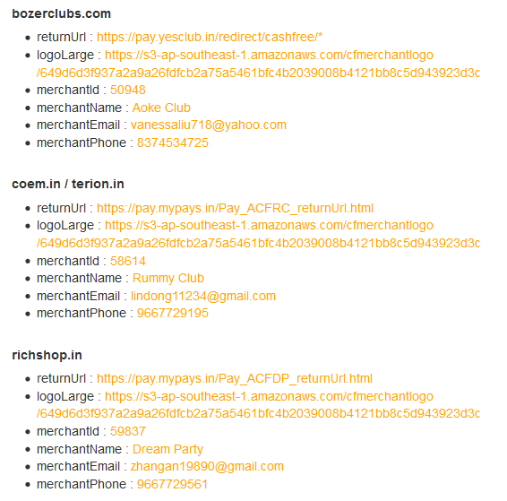
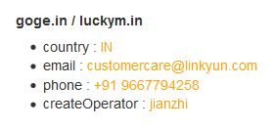
Evidences
merchant details linked to few domains.
All the email IDs look like addresses of Chinese people.

Slide 59



Evidences

Slide 60



Evidences
https://consumercomplaintscourt.com/lost-my-money-from-bank-cyber-crime/
https://consumercomplaintscourt.com/money-deducted-by-linkyun-technology-through-uoi-linked/
https://consumercomplaintscourt.com/paytm-fraud-via-linkyun-technology-private-limited/
https://consumercomplaintscourt.com/linkyun-te-on-trying-unauthorised-transaction/
https://consumercomplaintscourt.com/fraud-of-software-trading/

Slide 61


Slide 62
theHARVESTER
theHarvester is a very simple to use, yet powerful and effective tool designed to be used in the early stages of a penetration test or red team engagement.
Use it for open source intelligence (OSINT) gathering to help determine a company's external threat landscape on the internet.
The tool gathers emails, names, subdomains, IPs and URLs using multiple public data sources.
Example : theharvester -d domain.com -l 50 -b google -h myresults.html
-b domain
-l limit search page results
-b data sources
-h output results

Slide 63






What can I do with these images ?

Slide 64



Learn Reverse Image Search
Search by image and find where that image appears online
https://tineye.com/
https://www.bing.com/
https://yandex.com/images/
https://images.google.com/

Slide 65


META DATA Extraction
https://exifinfo.org/
Exiftool –kali linux

Slide 66

RECON-NG
Recon-ng is a full-featured Web Reconnaissance framework written in Python. Complete with independent modules, database interaction, built in convenience functions, interactive help, and command completion, Recon-ng provides a powerful environment in which open source web-based reconnaissance can be conducted quickly and thoroughly
Recon-NG lab

Slide 67

HUNT DOWN SOCIAL MEDIA WITH SHERLOCK.PY
https://github.com/sherlock-project/sherlock

Slide 68

Maltego is an open source intelligence (OSINT) and graphical link analysis tool for gathering and connecting information for investigative tasks.
Build Threat Graphs
Use transforms to generate leads and information
Visually explore relationships b/w data
MALTEGO LAB
MALTEGO

Slide 69
WEB SCRAPPING WITH PYTHON
Scrapping: Converting unstructured data to structured information
Web Scrapping: Technique to programmatically extract information from Websites
Focuses on converting data from html sites to analyzable data

Slide 70
Fetching the data:
Involves finding URL and endpoint
Sending HTTP requests to collect data
Example:
“import requests”
“data = requests.get(‘www.google.com’)”
“html=data.content”
Parsing the data:
Methods to search, navigate and select data items
“from bs4 import BeautifulSoup”
“Soup=BeautifulSoup(html,’html.parser’)”
divtag=soup.findAll('div',{'class':'result'})
links_a=soup.find_all('a')
Beautiful Soup is a Python library for getting data out of HTML, XML, and other markup languages.
Requests is Python library to perform HTTP requests and retrieve data from url endpoints.

Slide 71
LABS:
Instagram Scraping
Pastebin Bot
Extracting domain dns records
Github Scrapping
Scrapping Page links
Wappalyzer python
Scraping news from sumansa
Perform whois lookups with python
Extracting wikileaks data

Slide 72

Tracking Locations with seeker
Longitude
Latitude
Accuracy
Altitude
Direction
Speed
Along with Location Information we also get Device Information without any permissions :
Operating System
Platform
Number of CPU Cores
Amount of RAM - Approximate Results
Screen Resolution
GPU information
Browser Name and Version
Public IP Address
IP Address Reconnaissance

Slide 73

Steps
https://github.com/thewhiteh4t/seeker

Slide 74


Slide 75

Capture the Flag
Sign up - https://tryhackme.com

Slide 76




RULES
Steps to join CTF
Login to https://tryhackme.com
On the left choose My rooms
Use the room code to join CTF
Just don’t share the flag
Have fun finding ‘em

Slide 77

SCOREBOARD

